Slide 1
Retrieval-Augmented Generation (RAG)
By Panggih Kusuma Ningrum

Slide 2
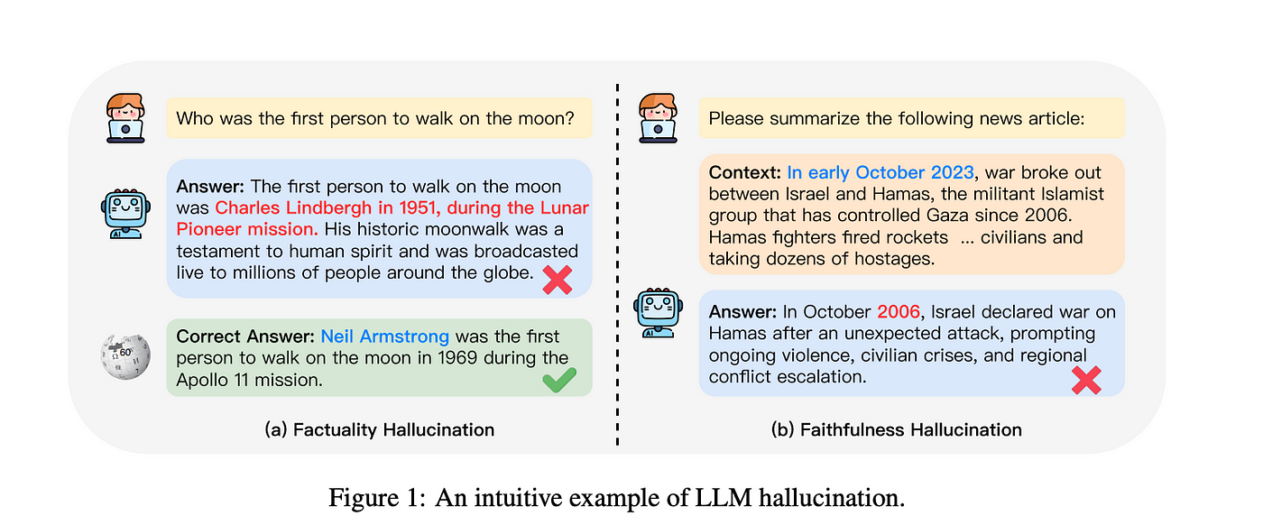
Issues

Slide 3
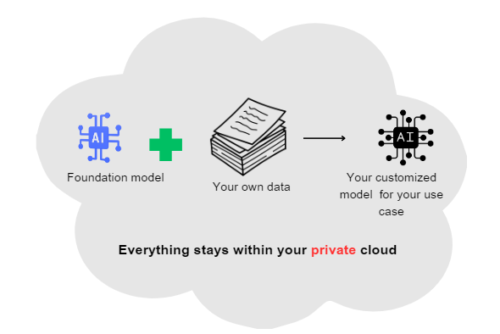
Issues

Slide 4
What is RAG
RAG is a hybrid approach that combines information retrieval and generative models to produce high-quality, contextually relevant text.
How it Works:
Retrieval Step: Fetches relevant documents or passages from a large corpus.
Generation Step: Uses a generative model (e.g., GPT-3, LLaMA) to produce a response based on the retrieved documents.
Benefits:
Enhances the factual accuracy of generated text.
Improves context relevance by grounding responses in real data.

Slide 5
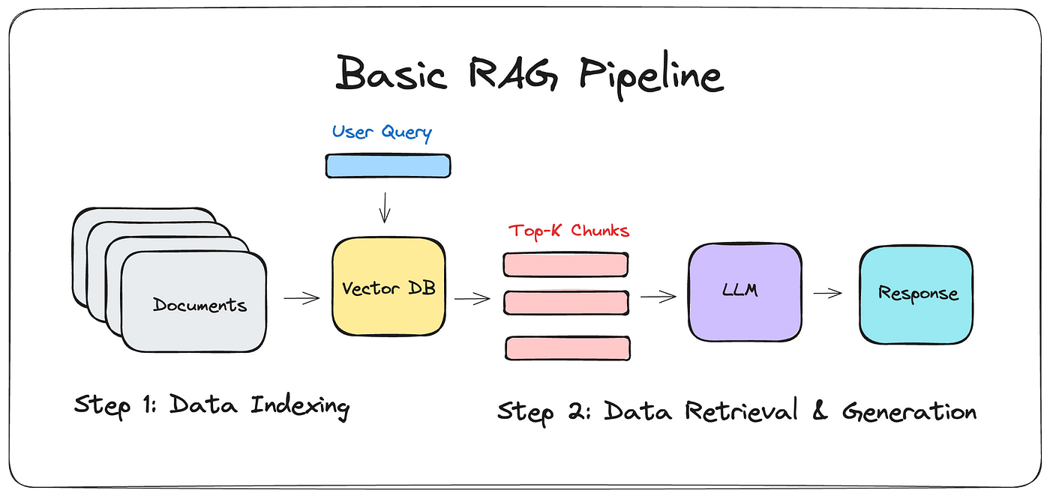
(Simple) Pipeline

Slide 6
(Simple) Pipeline
Offline Pipeline:
Document Collection: Gather a large corpus of documents.
Indexing: Preprocess and index documents for efficient retrieval.
Embedding Generation: Generate embeddings for document chunks.
Storage: Store embeddings and document chunks in a database (e.g., ChromaDB).
Online Pipeline:
User Query: Receive a query from the user.
Query Embedding: Generate an embedding for the user query.
Retrieval: Fetch relevant document chunks using the query embedding.
Generation: Use a generative model to create a response based on retrieved documents.
Output: Provide the generated response along with source information.

Slide 7
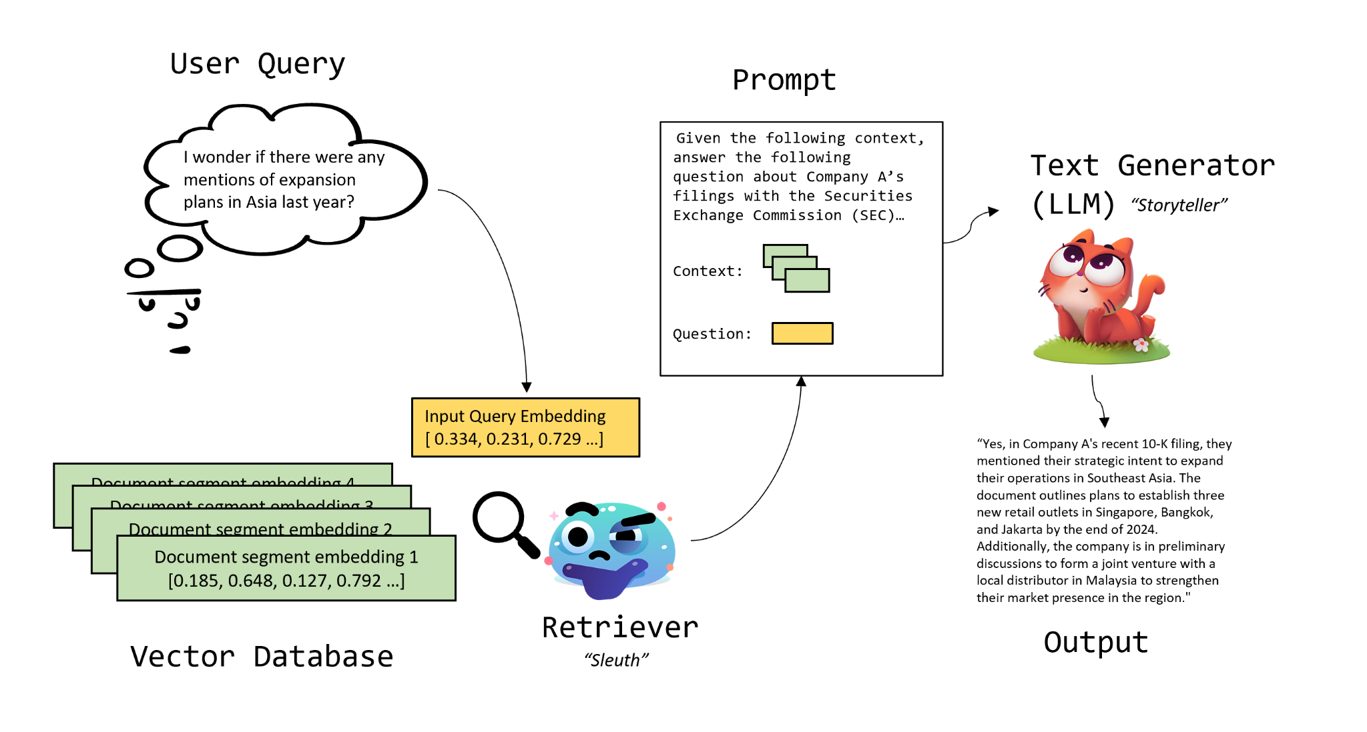
(Simple) Pipeline

Slide 8
The Potential of LLMs Implementation for RAG
Contextual Understanding:
Large Language Models (LLMs) can understand and generate human-like text, making them ideal for the generation step in RAG.
Scalability:
LLMs can handle vast amounts of data, enabling robust and scalable RAG systems.
Adaptability:
LLMs can be fine-tuned for specific domains, improving the relevance and accuracy of generated content.
Use Cases:
Customer support, research assistance, educational tools, and more.

Slide 9
The Challenges of RAG
Complexity:
Combining retrieval and generation introduces additional complexity in system design and implementation.
Latency:
The retrieval step can introduce delays, impacting real-time response generation.
Quality Control:
Ensuring the quality and relevance of retrieved documents is crucial for the effectiveness of RAG.
Resource Intensive:
Both retrieval and generation processes can be computationally expensive.

Slide 10
Things to be Aware of Using LLM in RAG
Bias and Fairness:
LLMs can reflect and amplify biases present in training data, indexing the results
Careful monitoring and bias mitigation strategies are essential.
Data Privacy:
Handling sensitive information requires stringent data privacy measures.
Hallucination:
LLMs can generate plausible-sounding but incorrect information.
Retrieval grounding helps, but vigilance is needed.
Maintenance:
Regular updates and retraining are required to keep the system relevant and accurate.
Attribution Issues:
Some LLMs are not totally open access
Inconsistency
Generative AI is not consistent

Slide 11
Sources:
Retrieval Augmented Generation (RAG) for LLMs
What challenges does the retrieval augmented generation approach solve?

Slide 12
Final Project
In this project, you will build a Retrieval-Augmented Generation (RAG) system that allows users to chat with PDF documents. You will use:
Hugging Face Embedding Models (e.g., sentence-transformers/all-mpnet-base-v2) for document retrieval.
Hugging Face Generative LLMs (e.g., google/flan-t5-large, mistralai/Mistral-7B-Instruct-v0.1) for answer generation.
Gradio for a user-friendly web interface.
GitHub to publish your code and a video demo.
You will present your work in the next meeting as a final report (4 July 2025)

